Slide 1

Hide N Seek
Exploring an unknown world via a POMDP.
Spring 2012
Josh Villbrandt
Divya Sharma
Prithvi Balaram

Slide 2
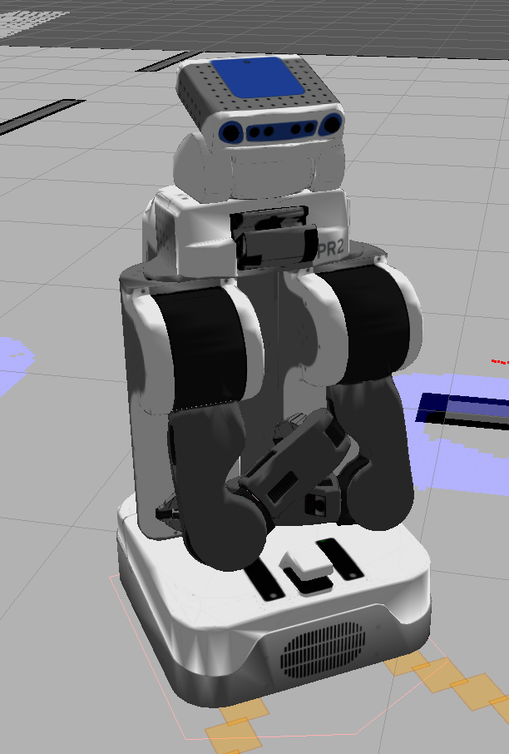
Agenda
Project Overview
Navigation Stack
People Finder
Interaction Diagram
Planning Task
POMDP Planner
Decision Model
Future Tasks

Slide 3
Project Overview
Focusing on the “seek” part of Hide and Seek
Problem is “how can we keep track of where we have been and decide where to go?”
Simulating a Kinect in order to “find a person”

Slide 4
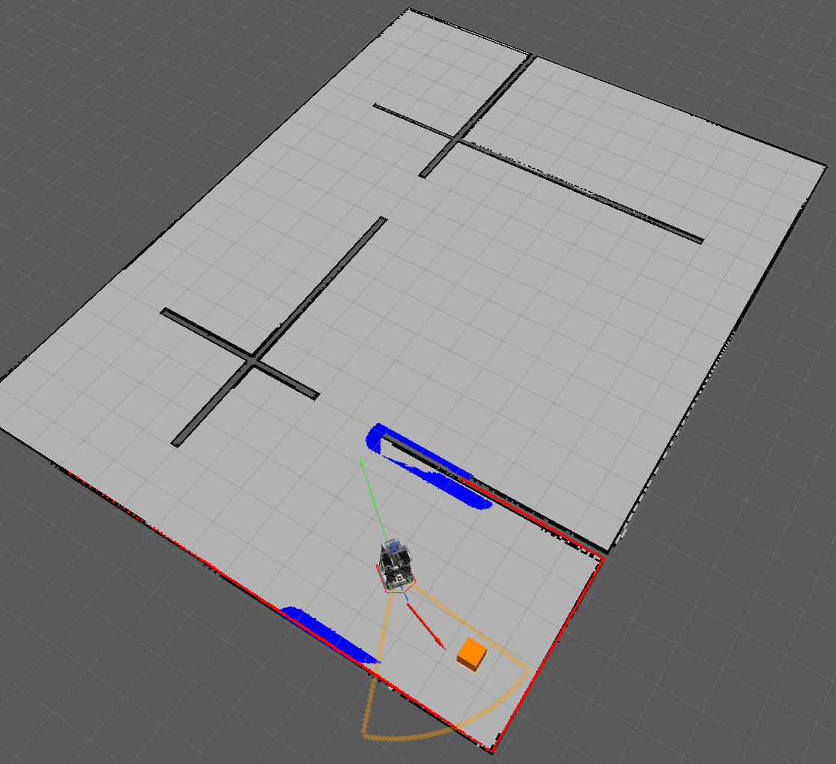
Navigation Stack
Gazebo physics simulation with a custom map
Online map generation with slam_gmapping
Simple navigation goals sent to move_base
  Handles obstacle avoidance
  Translates goal in to low-level motor commands

Slide 5
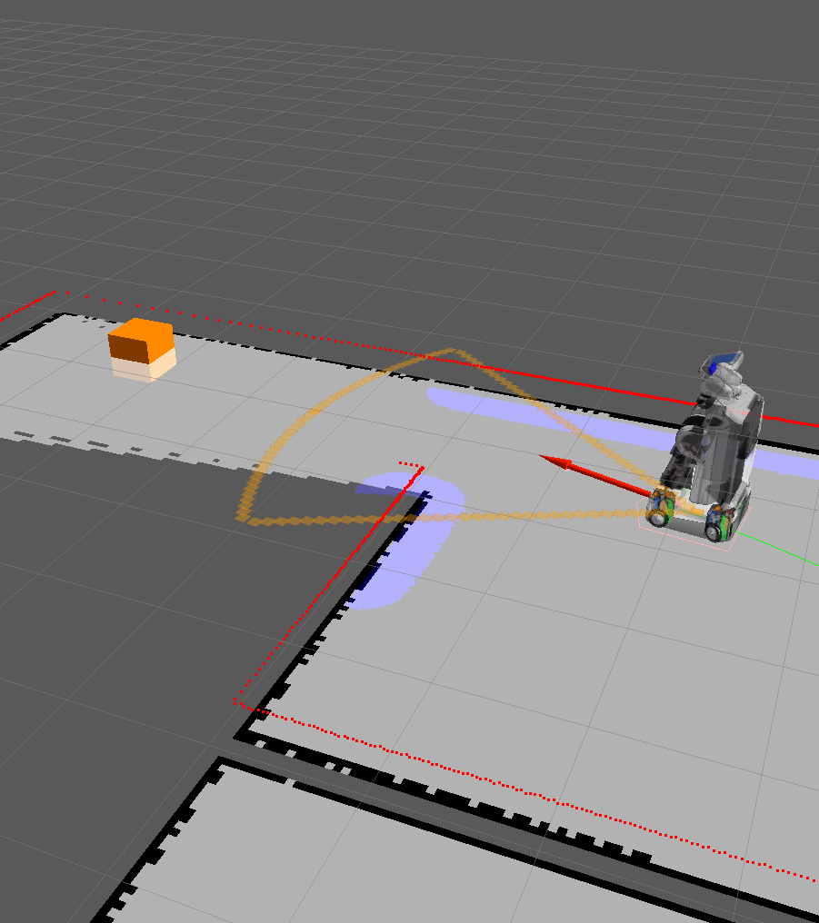
People Finder
Use an interactive marker to place a fake person in the world
Simulate Kinect range
  Shown as orange outline
Simulate Kinect reliability with noise
  5% false positives
  10% true negatives
Since this is modular, it could easily be replaced by a real Kinect node

Slide 6
Interaction Diagram
fake_people_finder
/fake_people_finder/people_finder
/move_base/goal
/map
move_base
planner
slam_gmapping
/people_finder/people_finder
/camera/rgb/points
people_finder
openni_camera
msg: people_finder
float32 sensor_range
float32 sensor_fov
geometry_msgs/Pose[] people
msg: move_base
geometry_msgs/Pose target_pose
msg: OccupancyGrid
MapMetaData info
int8[] data

Slide 7
Planning
How do we keep track of where we’ve been, and use that to figure out where we need to go?
We need to keep an internal model of the world that we can then use to calculate where the next most likely hiding place, and consequently travel to it.

Slide 8
POMDP
/map msg
Occupancy Grid
Internal State Rep
Belief
Update
Calculate Reward
Policy Iteration
Update the probability of each state with obstacle prob sent by msg.
Lower its prob if the state is seen before
With each new observation, calculate the 2D Euclidean dist, between goal and all the states
Policy Iteration called for planning
/goal msg
Decide Goal
People finder Pose messages
Highest rewarding State
Send
Nav Goal

Slide 9
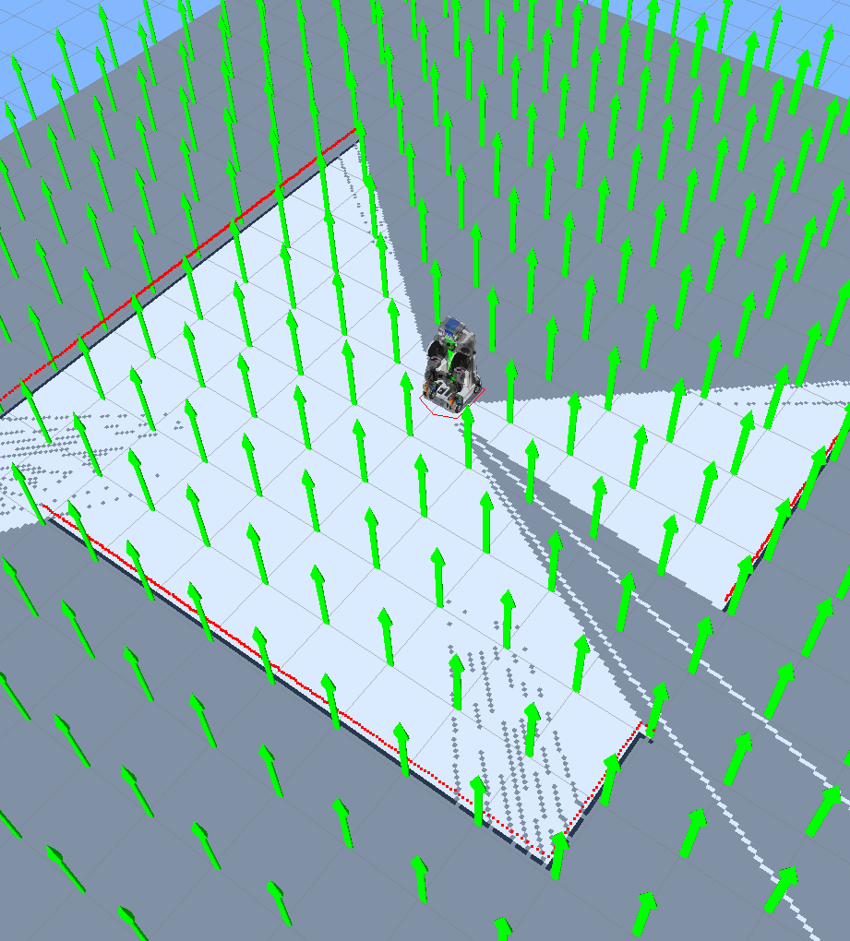
Decision Model
Sensor data
Goal State
Observation
Action
State
Reward
Transition
Belief
Planner

Slide 10
Future Tasks
Optimize the down-sampling from real to state space.
Fix sending of nav goals to unreachable states.
Fix selection of next goal to not select the same goal multiple times (local maxima).

